Slide 1
Analysis and Implementation
of a Food Recipe Generation Model
Yichen Lu

Slide 2
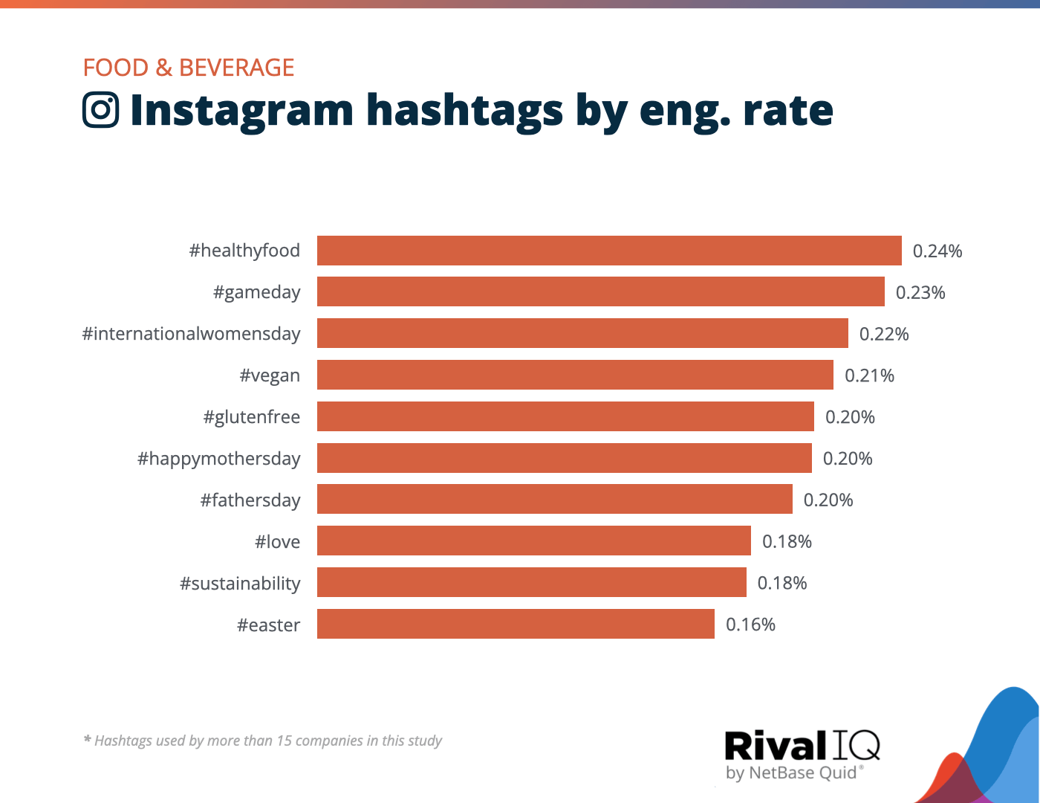
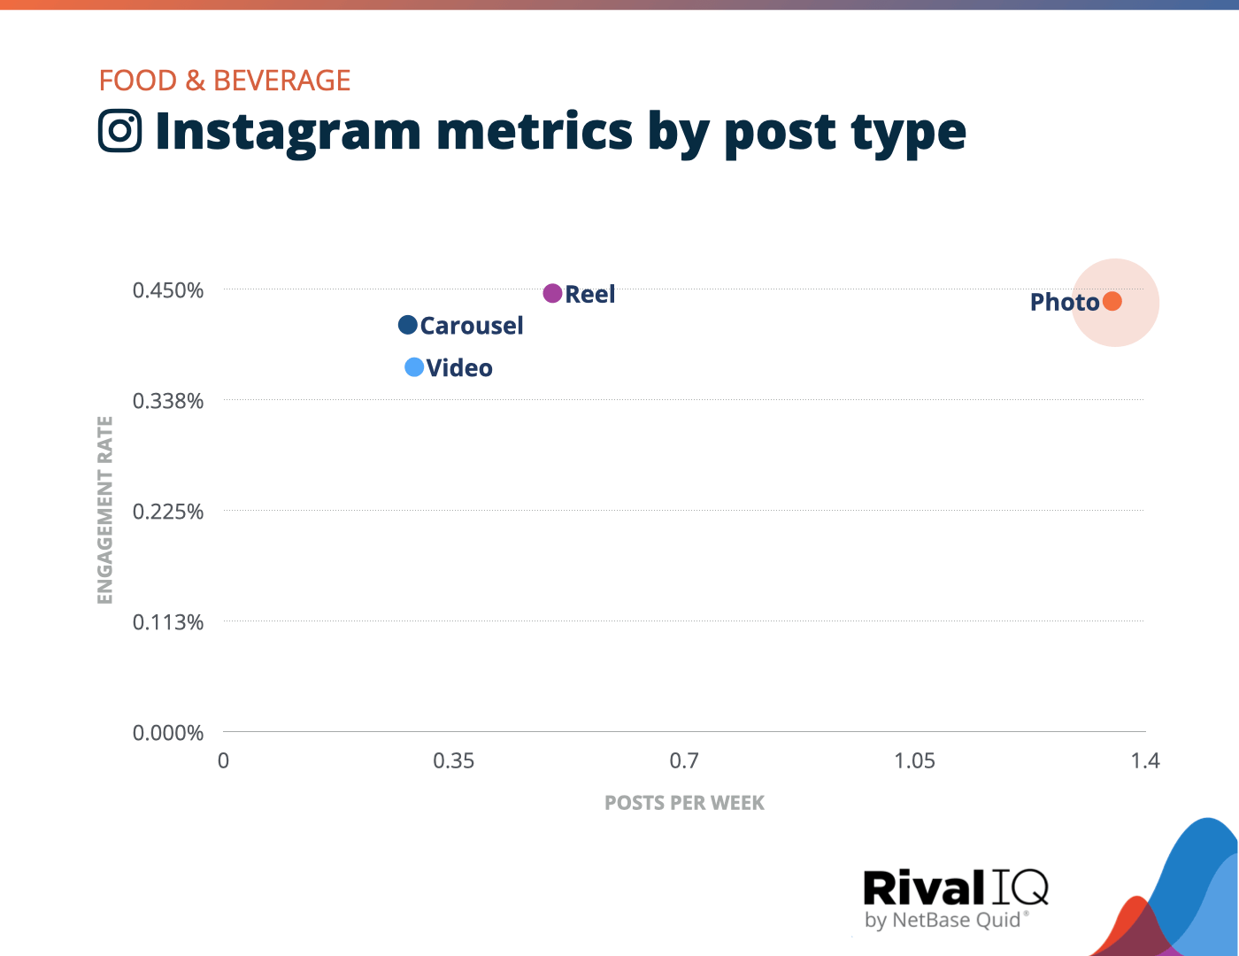
Modern food trends

Slide 3
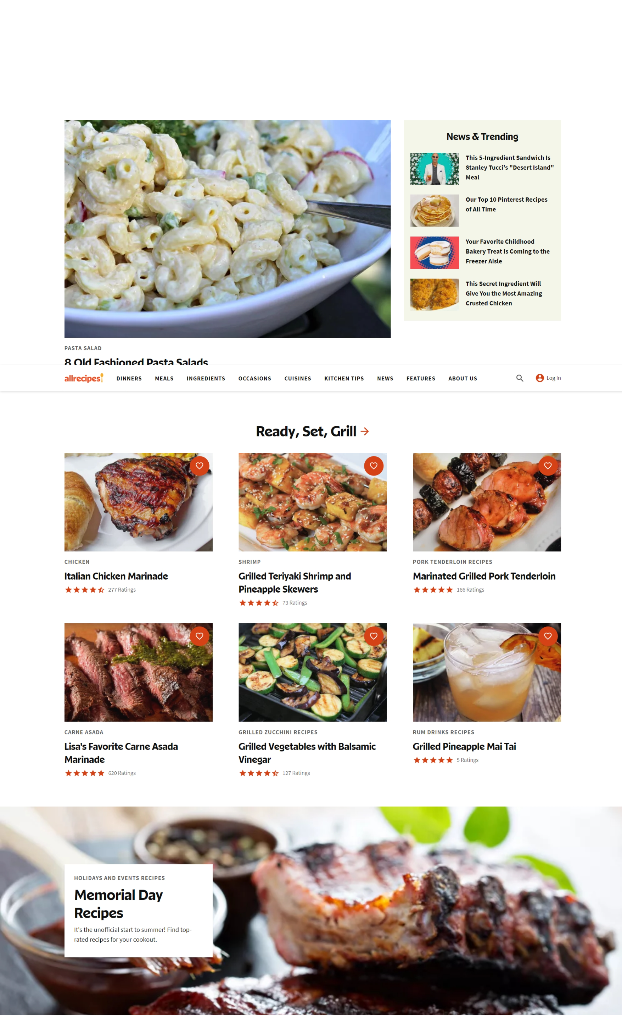
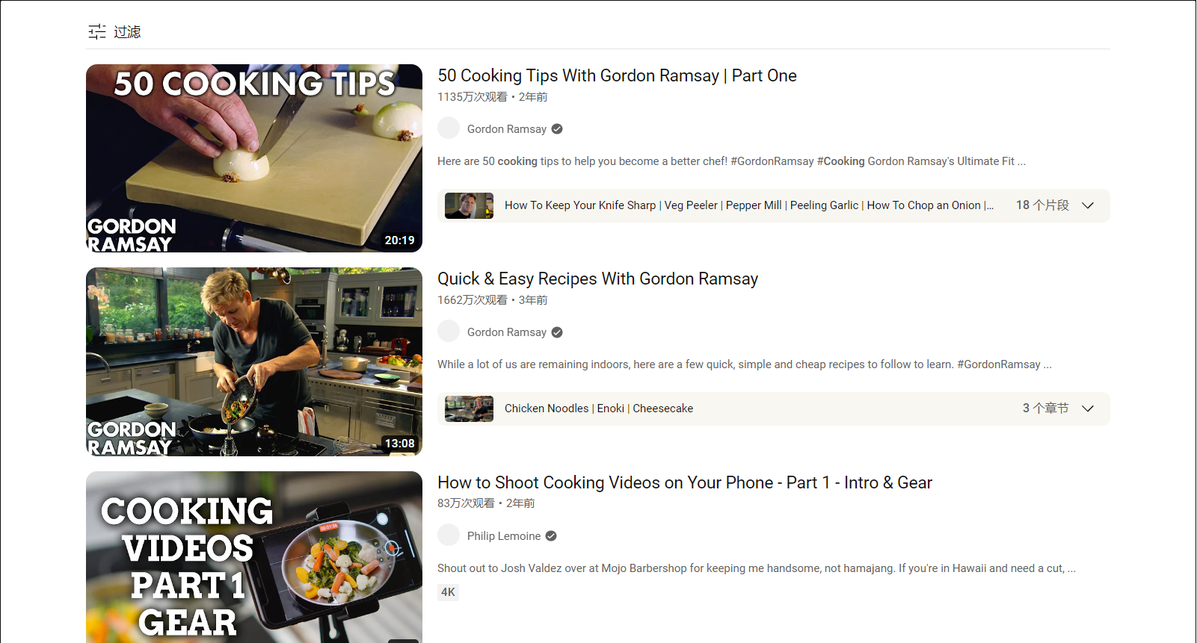
Methods

Slide 4
Related work
Food-Related Research: Numerous studies exploring diet preferences, nutrition analysis, eating behavior, food production safety, and food culture, yet a systematic approach was lacking until Min et al.'s framework for food calculation.
Developments: From Parrish et al.'s (1977) visual-based identification to the AI-powered food logging system by Kitamura's team and Bossard et al.'s "Food-101" image dataset, the field has evolved dramatically.
Recipe1M+ Dataset: A project by the Universitat Politecnica de Catalunya, MIT, and Qatar Computing Research Institute, providing a large-scale corpus of over a million cooking recipes and 13 million food images.

Slide 5
Related work
Food Image Recognition: A valued FGIC subfield with promising AI applications such as Amazon Fresh Go Store and FoodAI, that facilitates automatic payment, nutrient analysis, diet logging, and food recommendations.
Challenges & Advanced Methods: Traditional methods treat image-to-recipe generation as a retrieval task but face limitations. The Inverse Cooking project addresses this by treating it as a conditional generation task, predicting ingredients and generating a food preparation method for improved accuracy and explainability.

Slide 6
PROGRESS
Model Analysis
Practical Application
Propose solution models
Find current achievement
Improve algorithm
Design interface
Implement the optimised model

Slide 7
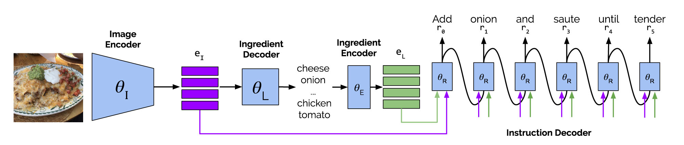
Models
Image to Recipe
Traditional indexing method
Powered by Recipe 1M+ (Large dataset capacity)[1]
Highly efficient
Low accuracy
Image to Ingredient to Recipe
Powered by Inverse Cooking [1]
Deep learning (Transformer)
Higher accuracy in large scale
Not inferior speed (enhanced by Pretrained model)
[1]: Recipe1M+: A Dataset for Learning Cross-Modal Embeddings for Cooking Recipes and Food Images - MIT
[2]: Inverse Cooking: Recipe Generation from Food Images - Meta Research (facebook.com)

Slide 8
Application
Interface
Back end
Vue.js
User friendly
Fully functional
Python
Flask
Quick response
For detailed software implementation, see Readme.md

Slide 9
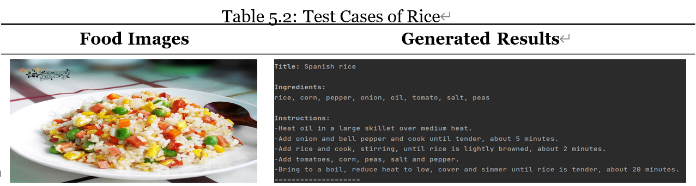
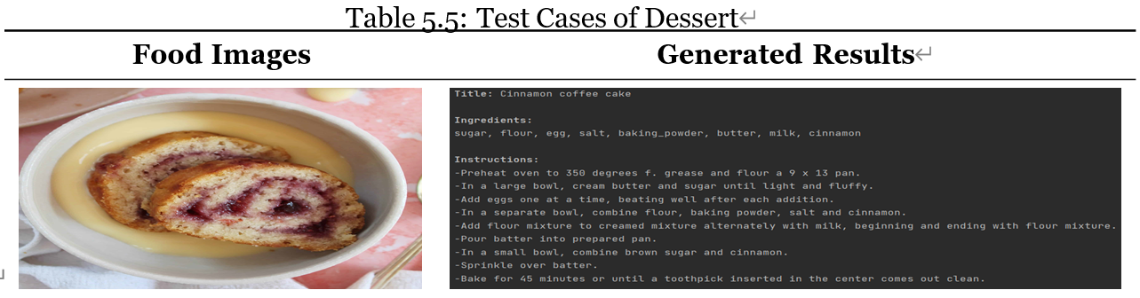
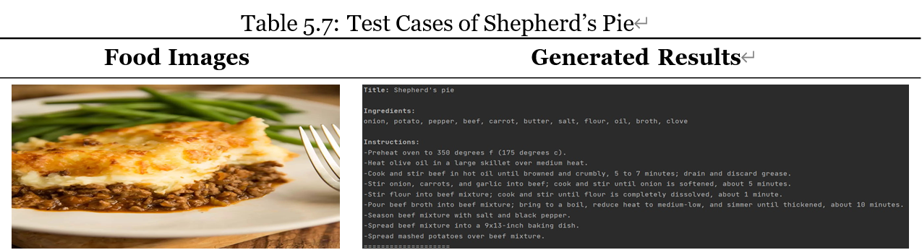
Software

Slide 10
Achievement
A more convenient method to learn cooking
An inspiration for people to discover new recipes
Exploration to global cuisine

Slide 11
Thank You
Yichen Lu
20215622
scyyl15@nottingham.ac.uk
ethan-charles/Desertation-2022 (github.com)

